Slide 1
GROUP‘s Work September 5th, 2022
Technology Dynamics MOT1412

Slide 2
Please use Brightspace for all information on MOT1412 Technology Dynamics
https://brightspace.tudelft.nl/

Slide 3
Organization of Group‘s Work: Overview
Introduction round (15 minutes)
Distribute the organization (15 minutes)
Name of the group (5 minutes)
Take-away group’s work (5 minutes)
What else to discuss? (5 minutes)

Slide 4

1. Introduction round (15 minutes)
Take your seats and settle in (5 minutes)
Introduce each other (1-2 minutes each), in particular about your
technological knowledge (B.A.)
skills, e.g. experience in chairing groups, taking notes, writing papers
Please be strict about the time!
Notes:
https://unsplash.com/photos/EtyBBUByPSQ 22.08.2022

Slide 5

2. Distribute the organization I (5 minutes)
Distribute the following tasks for this week (including the take-away group’s work):
chairing the two sessions
taking notes during the two sessions and
uploading all material on time.
Please take up your responsibilities as chairperson etc. from now onwards.
Notes:
https://unsplash.com/photos/tn57JI3CewI 22.08.2022

Slide 6
2. Distribute the organization II (5 minutes)
Please take notes in a document on what you agreed upon about chairing, taking notes and uploading.
Determine who is doing the tasks in the week of
September 12th
September 19th
September 26th
October 10th and
October 17th
Please take turns so that every group member gains experience.
Notes:
https://unsplash.com/photos/tn57JI3CewI 22.08.2022

Slide 7
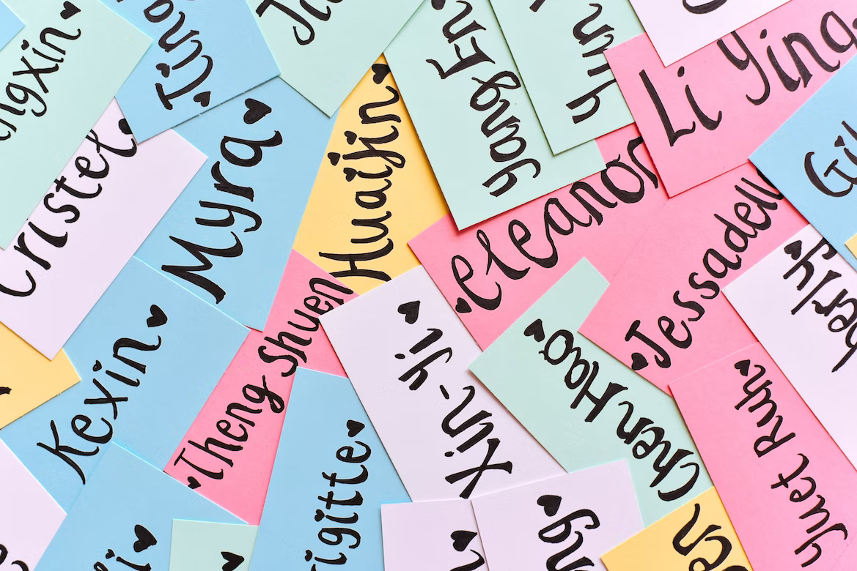
3. Name of the group (5 minutes)
Please pick a name for your group and create a group’s file on Brightspace with the name indicating the group’s members in brackets.
Please upload the document about what you agreed upon in 2. in this group‘s folder in the break following this session.
Notes:
https://unsplash.com/photos/JChRnikx0tM 22.08.2022

Slide 8
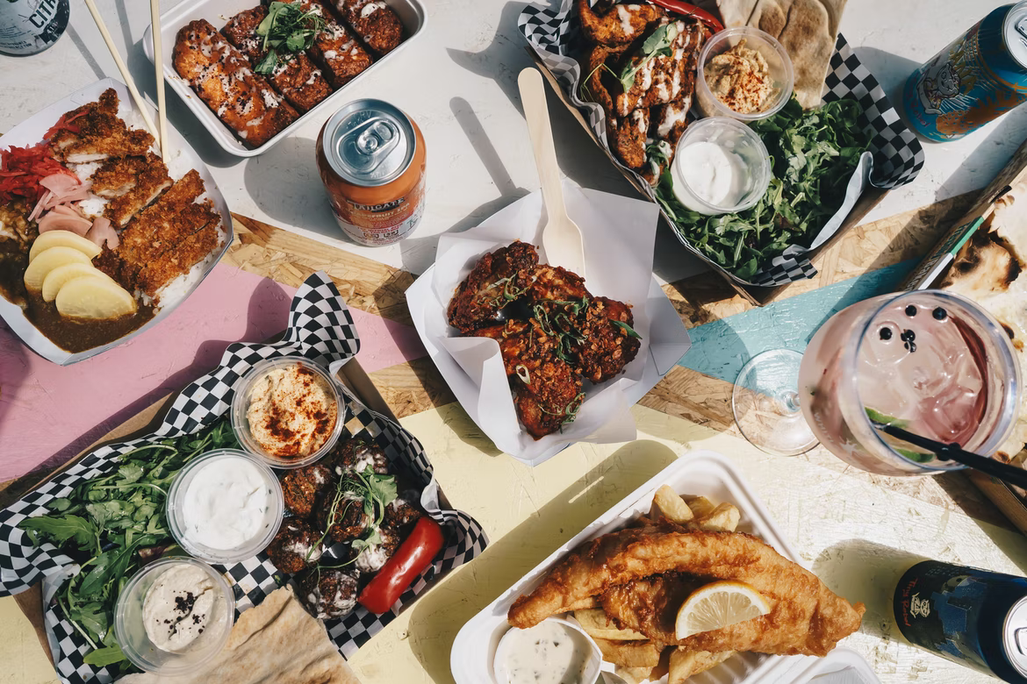
4. Take-way group‘s work (5 minutes)
In addition to the group’s work done directly after the lecture on Monday, we suggest that you organize another session for 1.5 hours of group’s work either physically or digitally.
Make sure that you take care of chairing, taking notes and uploading during this session as well.
Notes:
https://unsplash.com/photos/I8Ag046kfqc 22.08.2022

Slide 9
5. What else is to discuss? (5 minutes)
Anything else?

